Slide 1
Rich Mirror Alignment Code
Claire Prouve

Slide 2
AlignmentOnlineDev_v10r6
The version of AlignmentOnlineDev will change, just look at the latest on in /group/rich/sw/cmtuser!
AlignmentOnlineDev_v10r6
Rec
Rich
Installfiles…
Brunel
RichMirrAlign
RichMirrCombinFit
RichMirrorAlignmentOnline
RichRecSys
Determine individual mirror tilts.
Fit all the Δθ vs Φ histograms.
Steers the online alignment procedure.
How the histograms are made/ which histograms.

Slide 3
RichMirrorAlignmentOnline
RichMirrorAlignmentOnline
src
python
cmt
MirrPauseHandler.cpp
RichMirrorAlignmentOnline
PyMirrAlignOnline
Coordinates the writing of the histograms by the analyzers.
Configuration.py
Iterator.py
RichAnalyzer.py
…

Slide 4
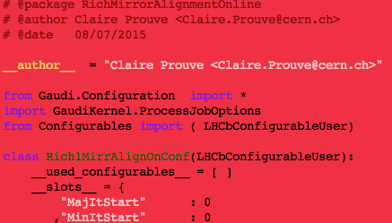
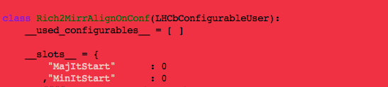
Configuration file (1/2)
Location: /group/rich/sw/cmtuser/AlignmentOnlineDev_v10r6/Rich/RichMirrorAlignmentOnline/python/RichMirrorAlignmentOnline/Configuration.py
1. Rich1MirrAlignOnConf
…
2. Rich2MirrAlignOnConf
…

Slide 5
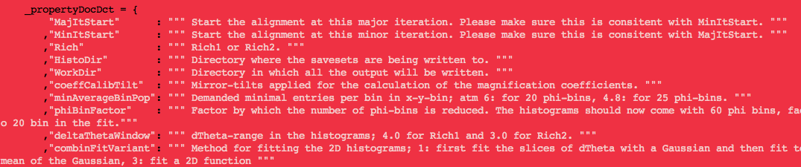
Configuration file (2/2)
Configuration-variables explained below the listing:
After a change: compile!
cd /group/rich/sw/cmtuser/AlignmentOnlineDev_v10r6
export OnlineDev_DIR=/group/online/dataflow/cmtuser/OnlineDev_v5r29/InstallArea/$CMTOPT
make –j 8 install
Or the corresponding version of OnlineDev listed in /group/rich/sw/cmtuser/AlignmentOnlineDev_v10r6/CMakeLists.txt

Slide 6
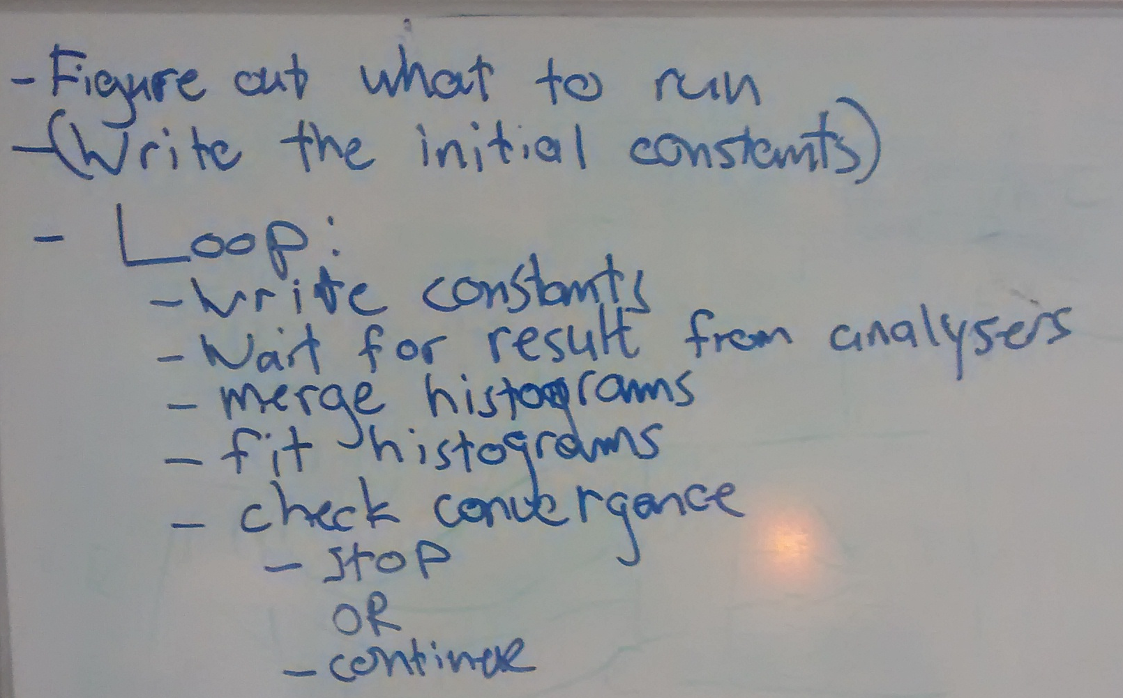
The Iterator (1/2)
Here is basically what the iterator does:
The Iterator contains most of the code that was previously in RichMirrorAlignment.py. It sets up all the xml-files, takes the rootfiles and executes RichMirrCombinFit and RichMirrAlign and makes the decision weather or not the alignment converged.
copy
Iterator does all his work while he is in state paused. When his thing is done he sets his own state to running and then the analyzers know to run too.
Iterator code: /group/rich/sw/cmtuser/AlignmentOnlineDev_v10r6/Rich/RichMirrorAlignmentOnline/python/PyMirrAlignOnline/Iterator.py

Slide 7
The Iterator (2/2)
Everything happens in the run() method (more comments can be found in the code):
1. whichRich is provided by the choosing Rich1 or Rich2 in the run-control while running the alignment.
2. The configuration is read in and variables are set.
3. The while loop begins.
4. At the start of the first iteration the work-directory will be emptied out.
5. The starting xml-file is gotten from '/group/online/alignment/Rich' + str(whichRich) + '/MirrorAlign/'
5. The xml-files for the mirror-tilts for the magnification coefficients are made.
6. The xml-file for the first iteration put in the place where the analyzers will pick it up.
7. Set Iterator state to READY which will make the analyzers run their jobs.
8. When the analyzers are READY the iterator will get the command "pause" and will check if one major iteration has been finished already:
- if not then it just copied the xml file for the next iteration to the place where the analyzers can pick it up
- if yes it will perform the fits and the alignment and check weather or not is has converged. If yes it's finished, if no it starts again at 7.

Slide 8
The Analyzer
The Analyzer is the entity that will execute the Brunel jobs and produce the histogram files.
The Analyzer code contains the options!!! for the Brunel jobs, the code that you can see in the RichAnalyzer.py is only executed once when the program is ‘configured’.
The analyzer is quite dumb, it can only pick up the xml-file for the reconstruction in one place (which means before each reconstruction the Iterator needs to put it in the right place in /group/online/AligWork/Rich1/CondDB_Rich1.xml or /group/online/AligWork/Rich2/CondDB_Rich2.xml ).
Analyzer code: /group/rich/sw/cmtuser/AlignmentOnlineDev_v10r6/Rich/RichMirrorAlignmentOnline/python/PyMirrAlignOnline/RichAnalyzer.py

Slide 9
The Helper-Files
A lot of functions and methods the iterator uses are outsourced into “Helper-files”:
RichAlignmentHelper.py, SetupHelper.py, HistoHelper.py, XMLFileHelper.py
SetupHelper: cleans out the work-directory, write summary file at the end of alignment…
XMLFileHelper: handles the XML files, gets the starting XML, makes the tilted XML-files for magnification coefficients…
HistoHelper: contains classes that wait for and retrieve the SaveSets (= output from the Analyzers) and copies them into working directory
RichAlignmentHelper: executes the methods needed for/using the RichMirrCombinFit and RIchMirrAlignpackage

Slide 10
RICH Mirror Alignment Code
The online alignment code is in
/group/rich/sw/cmtuser/AlignmentOnlineDev_v10r6
This project contains everything the online alignment needs and needs to be setup exactly this way.
All the Rich-specific stuff will be in
/group/rich/sw/cmtuser/AlignmentOnlineDev_v10r6/Rich
The code that drives the alignment is in
/group/rich/sw/cmtuser/AlignmentOnlineDev_v10r6/Rich/RichMirrorAlignmentOnline/python/PyMirrAlignOnline/
and the configuration file is in
/group/rich/sw/cmtuser/AlignmentOnlineDev_v10r6/Rich/RichMirrorAlignmentOnline/python/RichMirrorAlignmentOnline/Configuration.py
The actual alignment is started in (this ‘belongs’ to everyone)
/group/online/dataflow/cmtuser/OnlineDev_v5r29/Online/FarmConfig/job/AligDrv.sh

Slide 11
RICH Mirror Alignment Code
The output of the alignment will be in (including the histograms)
/group/online/AligWork/Rich1
/group/online/AligWork/Rich2
The MirrPauseHandler (the one that coordinates the writing of the histograms)
/group/rich/sw/cmtuser/AlignmentOnlineDev_v10r4/Rich/RichMirrorAlignmentOnline/MirrPauseHandler.cpp
Original Histogram output location:
/hist/Savesets/2015/LHCbA/AligWrk_Rich1
/hist/Savesets/2015/LHCbA/AligWrk_Rich2

Slide 12
Compiling
Compiling the code in AlignmentOnlineDev_v10r6:
cd /group/rich/sw/cmtuser/AlignmentOnlineDev_v10r6
export OnlineDev_DIR=/group/online/dataflow/cmtuser/OnlineDev_v5r29/InstallArea/$CMTOPT
make configure
make –j 8 install

Slide 13
Monitoring
Problem: monitoring runs on the monitoring farm, the alignment runs on the alignment farm ➔ cannot use DIM to communicate between the alignment and the monitoring task
Use zeroMQ to send the name of the newest histograms to the monitoring task (this part already works)
Monitoring tasks awaits information (in that order): iteration (int), Histogram file(string), RichMirrAlign_out file (string).
From the histogram file the Cherenkov angle is fitted and filled into monitoring-histogram with resolution as y and iteration number as x
From the RichMirrAlign_Out file the mirror tilts for the current iteration are extracted and filled into 2D histogram
Special feature: at the beginning of the task the monitor searches for the last converged alignment and put the last Cherenkov-angle resolution into the histogram under iteration -1

